Slide 2
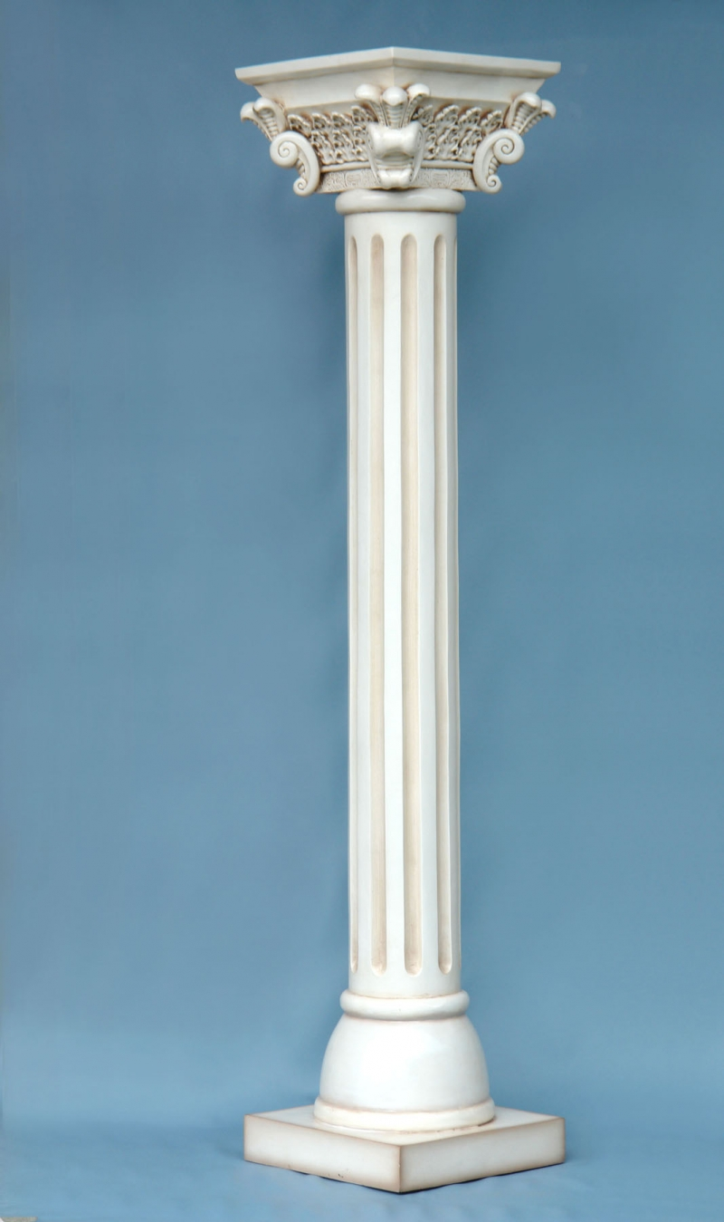
PILLar
A Dashboard for Internet of Things

Slide 3
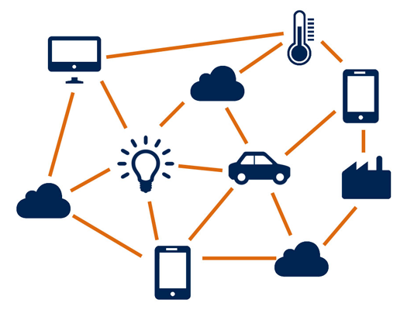
Notes:
The Internet of things is new and growing paradigm in which everyday objects connect to the internet, allowing them to send and receive data, allowing you stay home even when you're away.
Crock Pot
Fridge

Slide 4
The IoT is big news because it ups the ante: ‘Reach out and touch somebody’ is becoming ‘reach out and touch everything.’
-Parker Trewin,
Senior Director of Content and Communications, Aria Systems

Slide 5
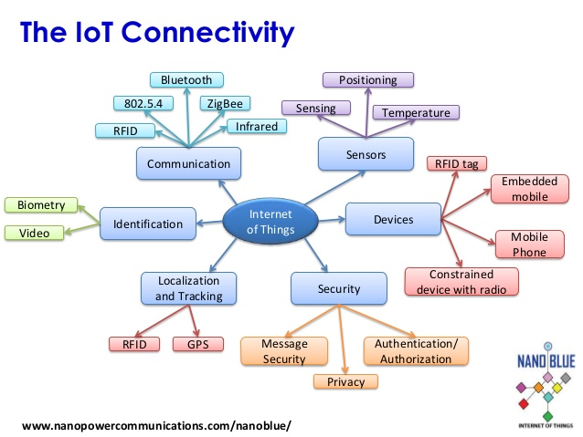
Notes:
IoT uses a wide range of technology

Slide 6
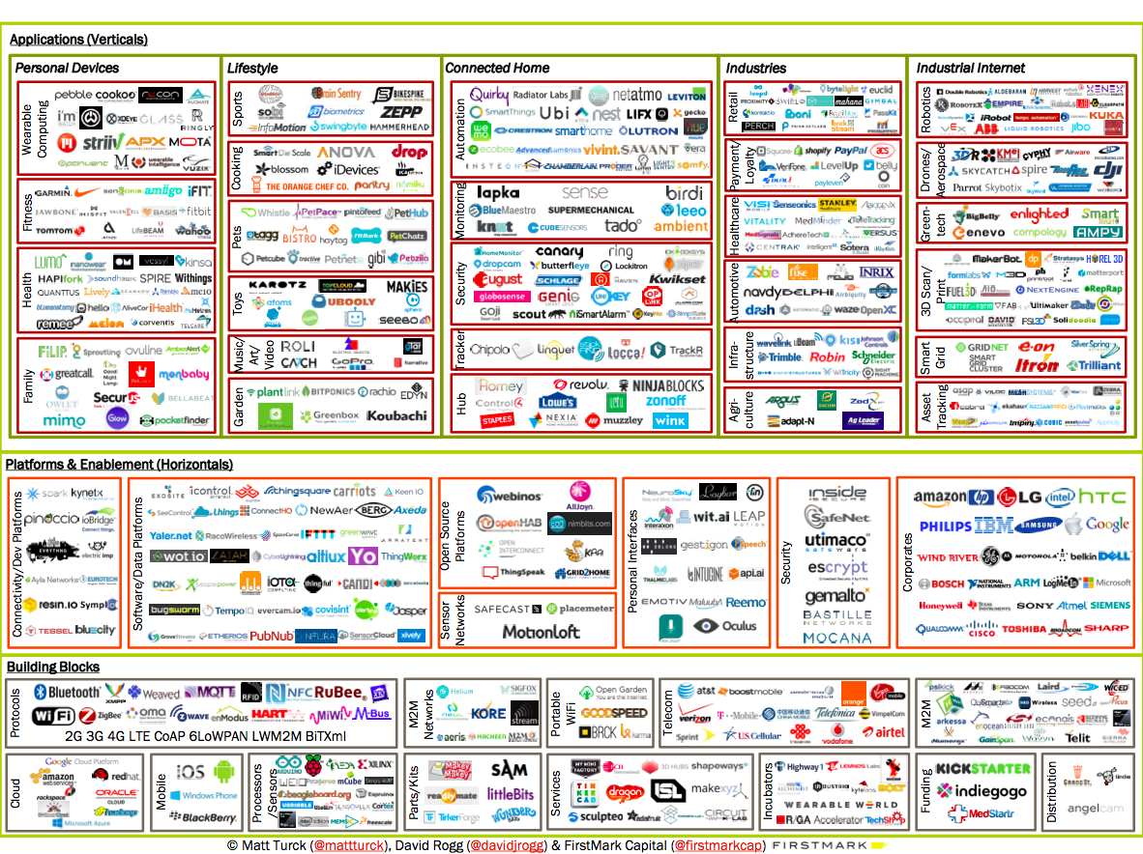
Notes:
Different products can use different protocols
Need to create universal tool that can be used any number of modules to communicate with all platforms

Slide 7
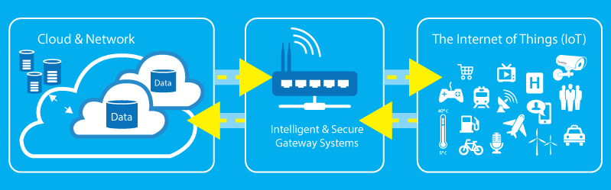
Project Goals
Universal IoT interface
Intuitive UI (Pillar Dashboard)
Stable data model
Data analytics
Notes:
Universal Interface: Something that can easily include many different modules to simplify interconnectivity
Intuitive UI: Create UI that is easy for a user to use.
These exists, but we want a single UI for all types of devices
Stable Data Model: There is a need for a model that could include any IoT data.
Versatile
Data Analytics: Use information from IoT that facilities better usage of IoT devices.
Help user with decision making

Slide 8
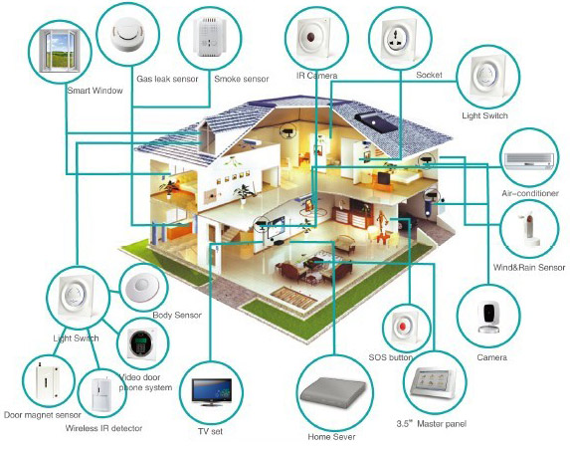
Universal IoT Interface
Avoid extra interfaces
Platform independent
Modularity
Notes:
Single interface for all devices
Communicate via RF, IR, WiFi, etc.

Slide 9
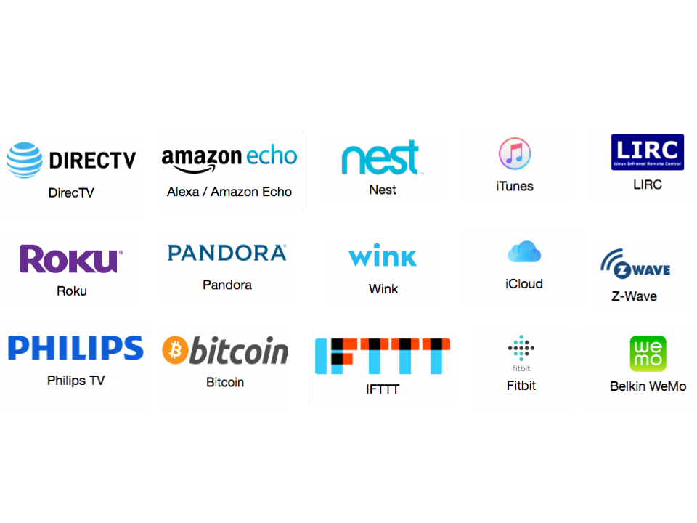
Home assistant — 461 Existing Components
Notes:
Controls all the smart devices
Accessible via a domain name(over internet)

Slide 10
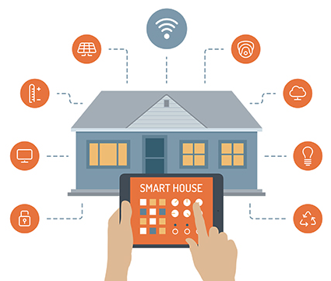
Pillar Dashboard
Groups devices by room
Accessible via Internet
Single interface for all IoT
Notes:
Controls all the smart devices
Accessible via a domain name(over internet)
Provides controls over each device

Slide 12
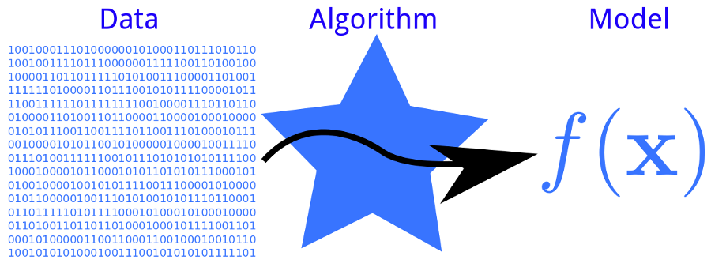
Data Analytics
Power consumption
Temperature
Device usage
Health
Notes:
The algorithms exist. The data does not.
Facilitate better decision making by user
Provide insight into device usage. Even personal habits

Slide 13
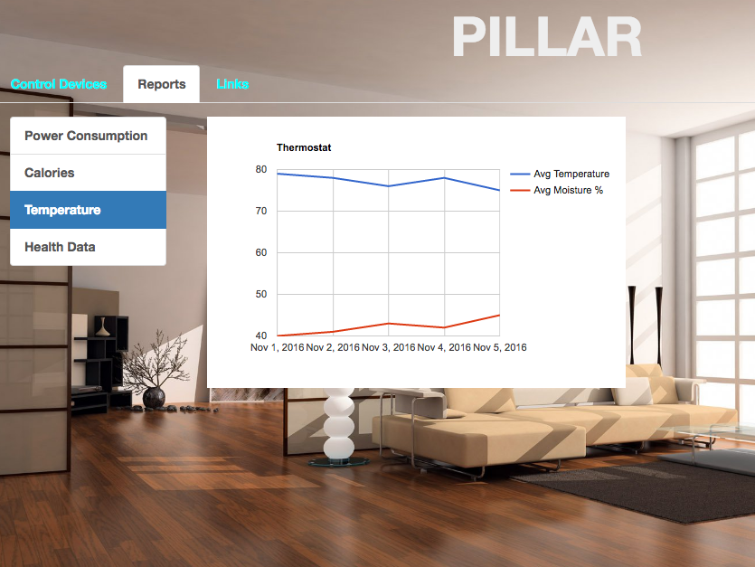

Slide 14
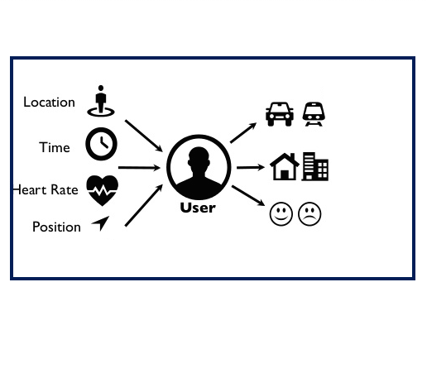
Stable Data Model
User oriented
Data mining friendly
Notes:
Data model acts as relation between the user and data
Currently focuses on user interactions with IoT devices.

Slide 15
Future SCope
Dashboard interface to add devices
Automate Homeassistant configuration
User health
Integrate Health Level 7 (HL7) data model
Smart home to smart city
Intelligent Pillar

Slide 16
Special Thanks
Pillar Team
Kiran Yedidi
Teja Kakulvar
Wennan Ma
Hugh DeJarnette

Slide 18
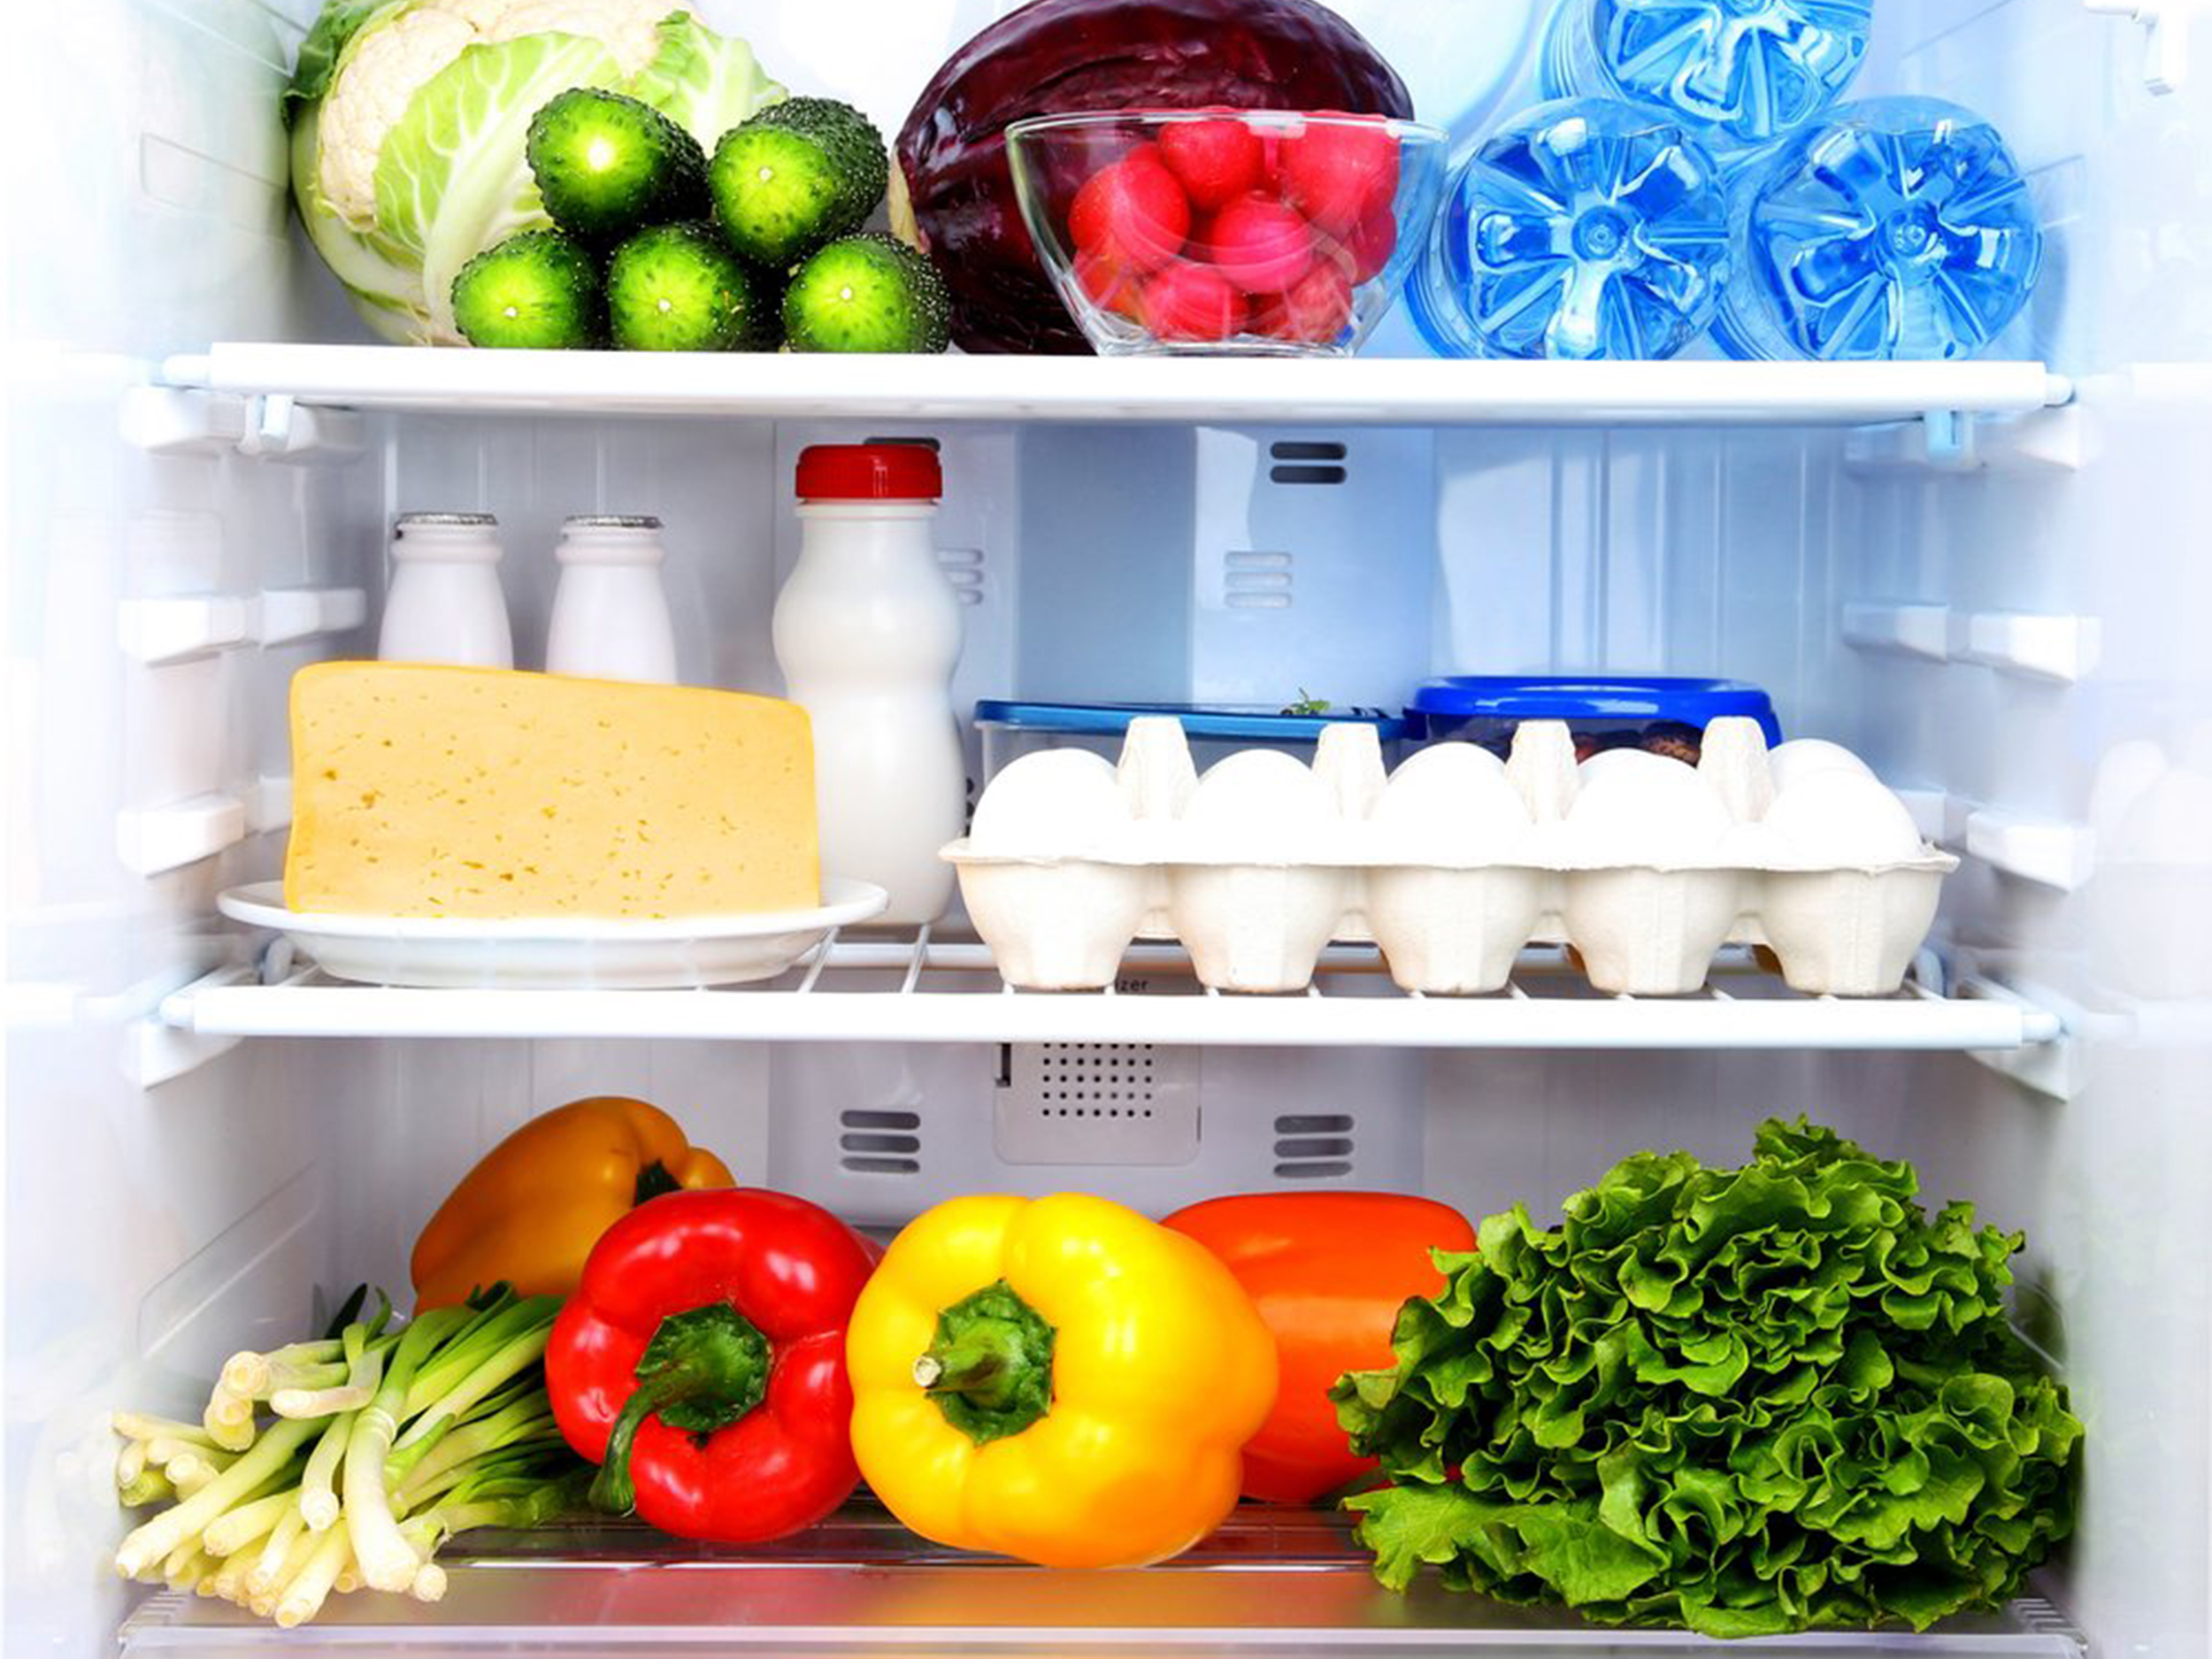
ICEBOX
Smart Kitchen Assistant

Slide 19

Why Smart Fridge?
know what is in your fridge
average Americans waste 25% of food from grocery store
know when items are about to expire
keep track of nutritional intake

Slide 20
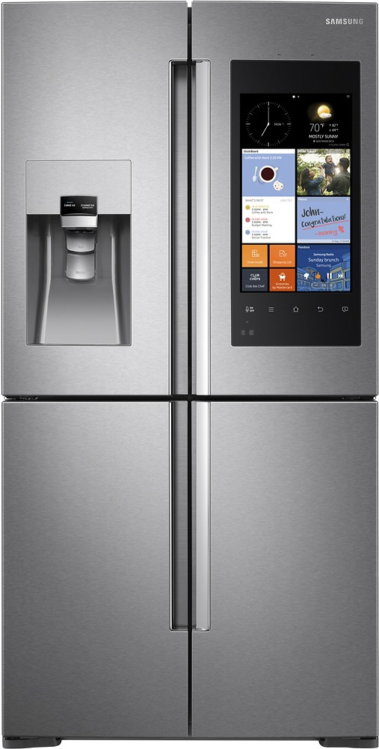
Commercial Smart Fridges
expensive (~$4000)
requires the purchase of an entirely new fridge
Smart Refrigerator App
inexpensive (~$100)
works with your current “dumb” refrigerator

Slide 21
Commercial Smart Fridges
expensive (~$4000)
requires the purchase of an entirely new fridge
Smart Refrigerator App
inexpensive (~$100)
works with your current “dumb” refrigerator

Slide 22
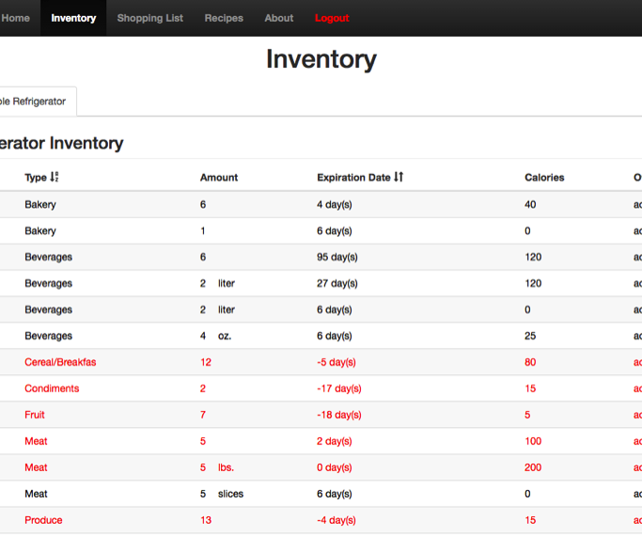

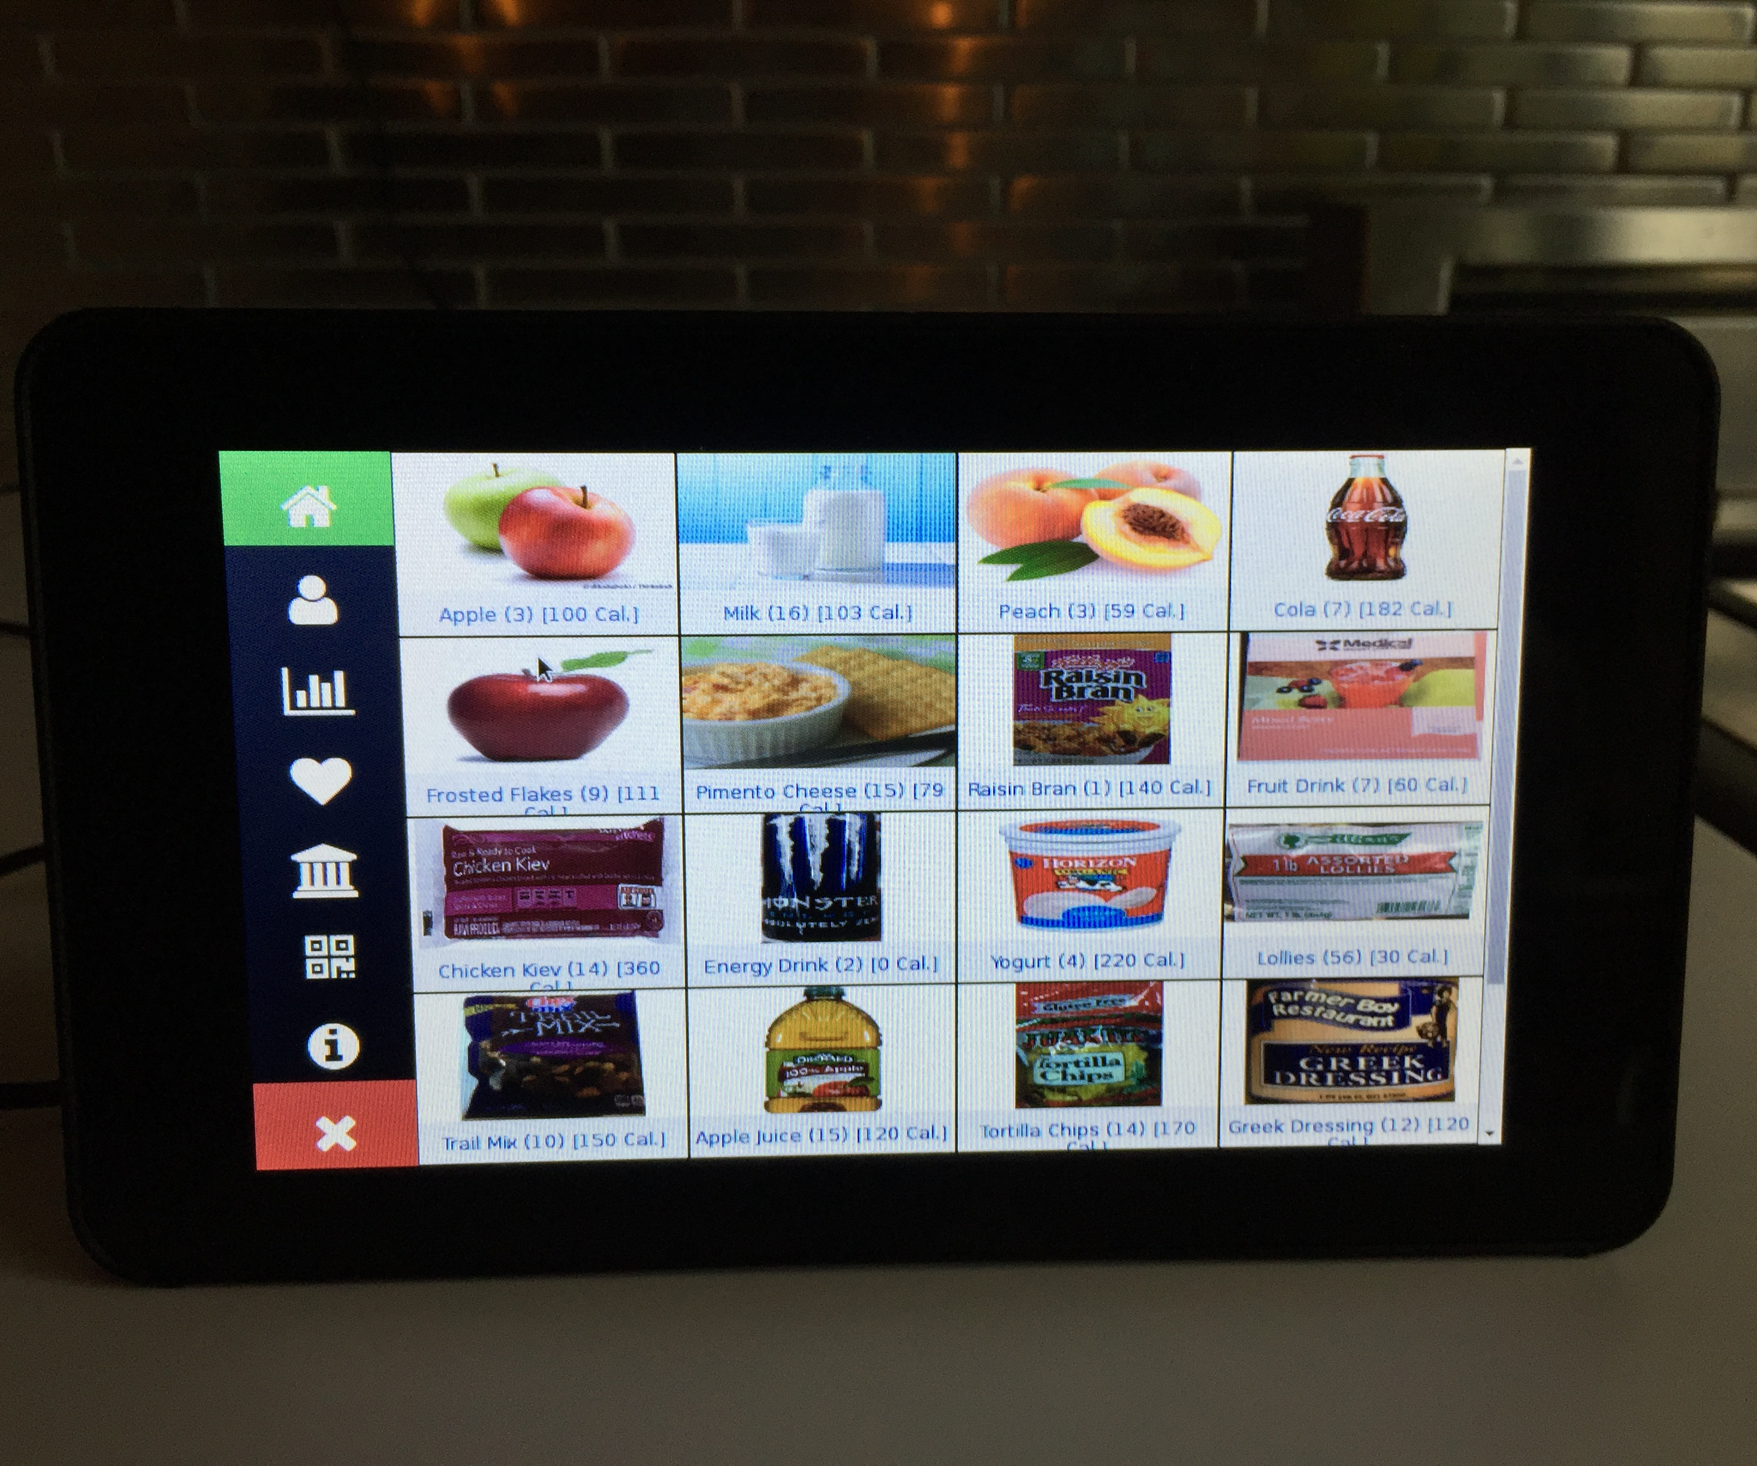
Smart Refrigerator App
requires computer to access
updating inventory is tedious
decrementing is intrusive
expired food into shopping list
Smart Refrigerator App
requires computer to access
updating inventory is tedious
decrementing is intrusive
expired food into shopping list

Slide 23
Smart Refrigerator App
requires computer to access
updating inventory is tedious
decrementing is intrusive
expired food into shopping list
ICEBOX
Kitchen Kiosk for easy access
Bulk update using e-Receipt
decrement food from Kiosk
estimates user waste

Slide 24
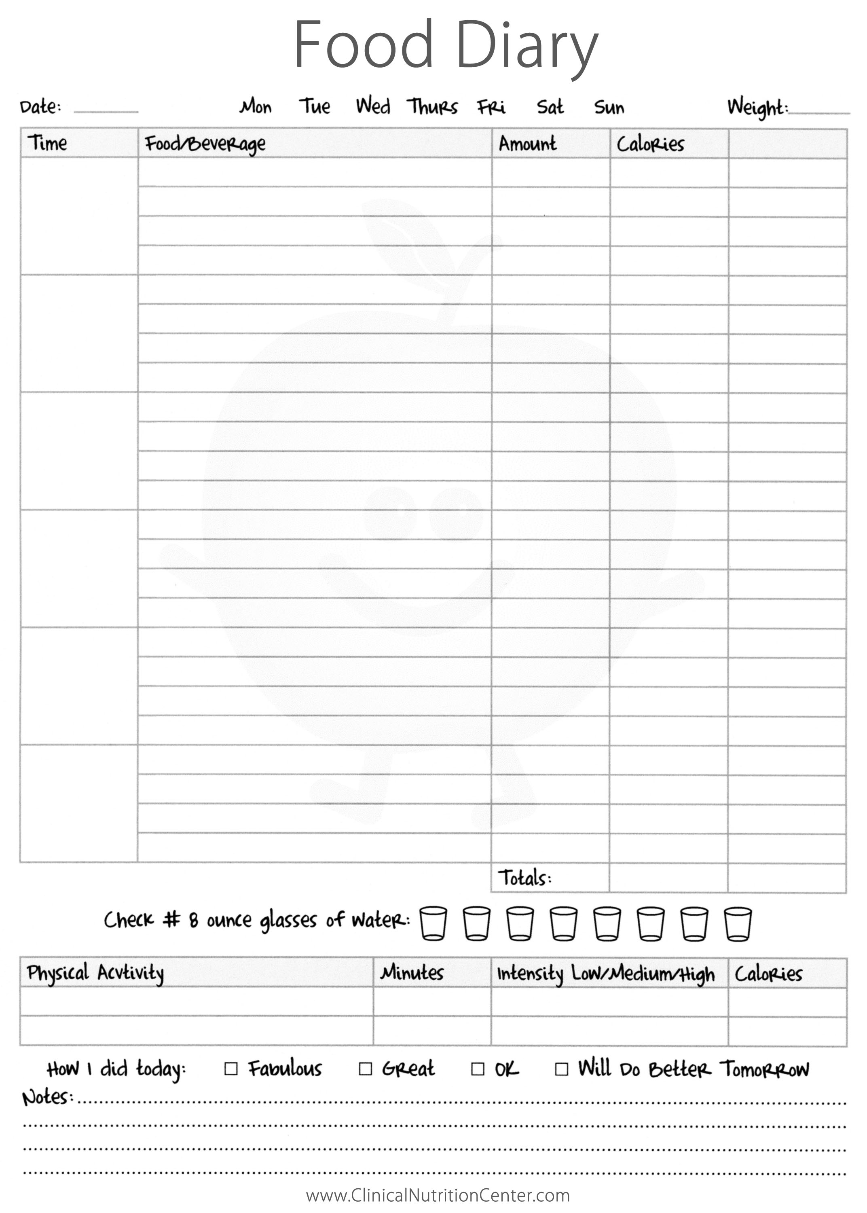
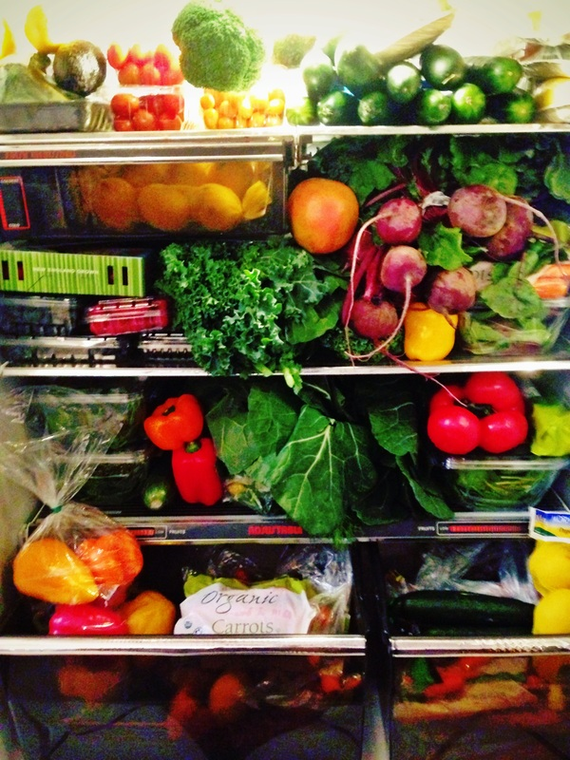
More Features
Nutrition Tracker
Meal Recommendation based
on Food in Fridge*
on Chosen Diet Plan
Ideal Temperature Recommendation
Determines Fridge Capacity

Slide 25
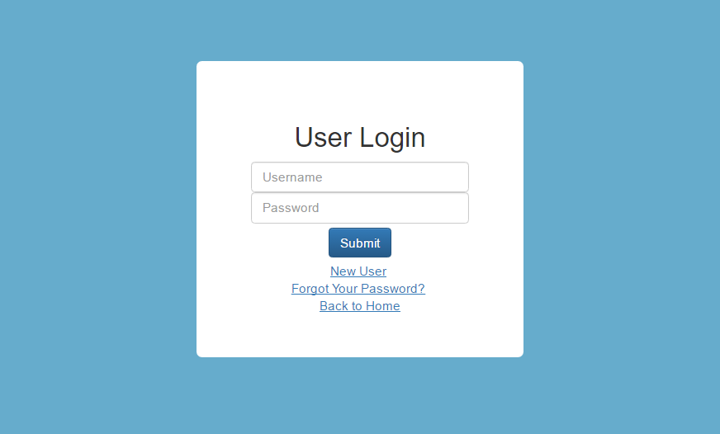
Scenario 0: I need to Access the Webpage

Slide 26
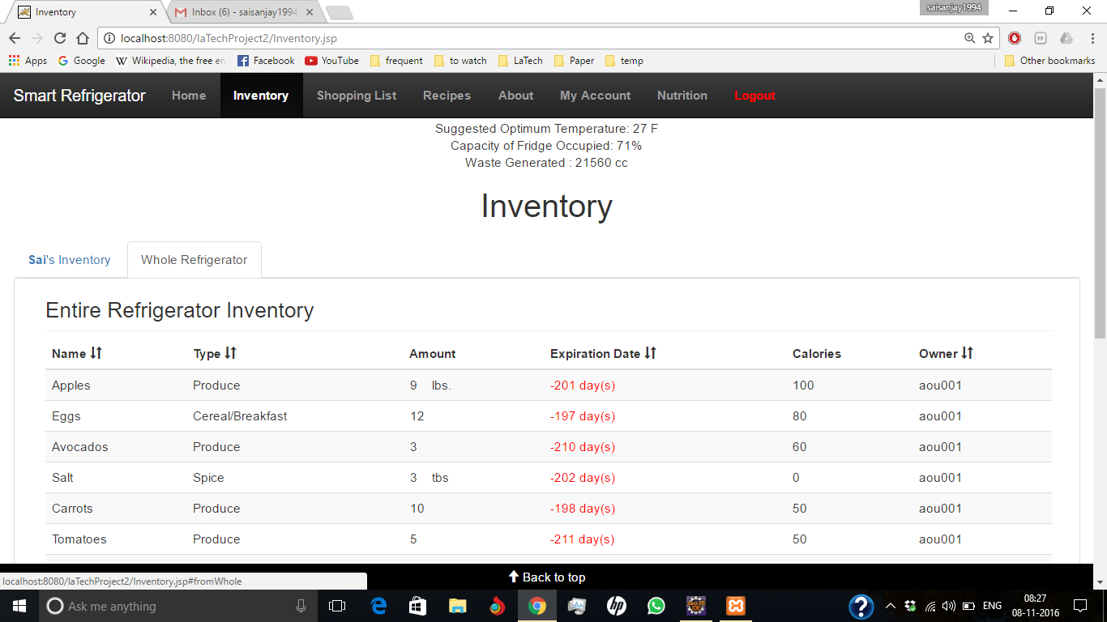
Scenario 1: I’m Hungry. What is there to eat?

Slide 27
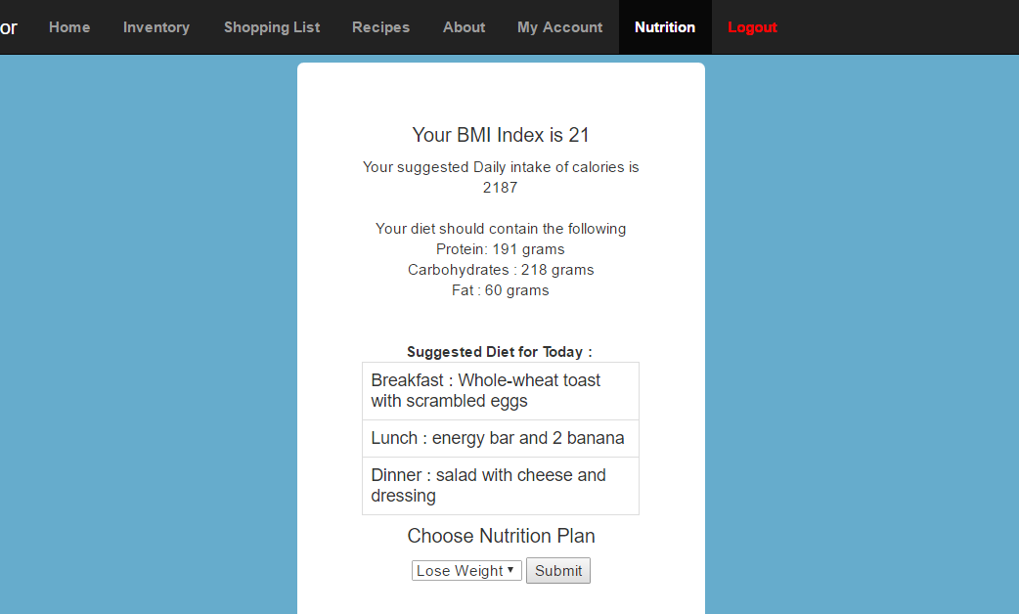
Scenario 2: What Have I eaten today?

Slide 28
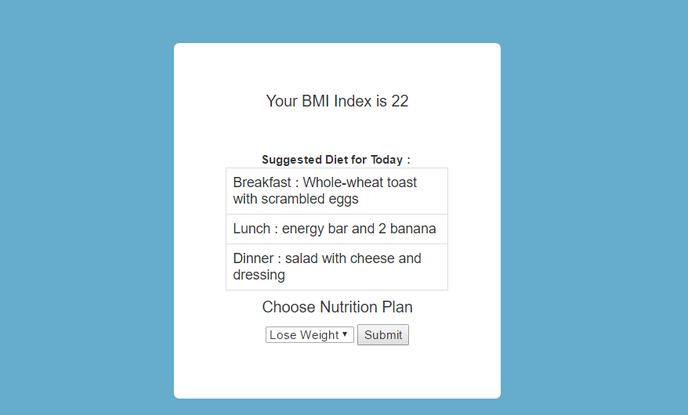
Scenario 3: What Should I eat?

Slide 29
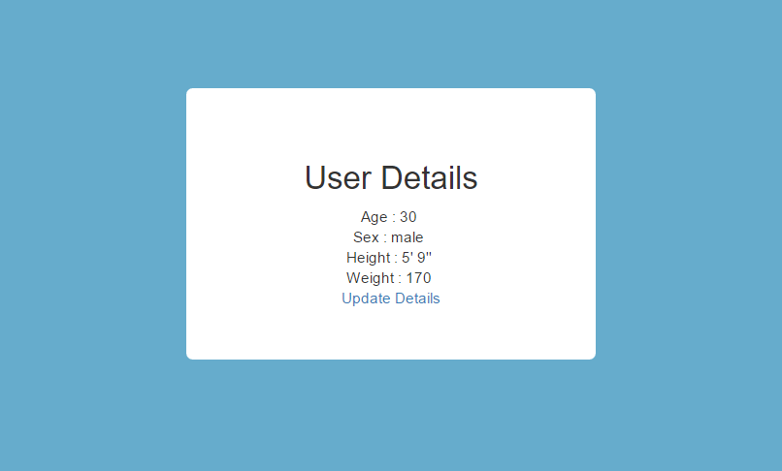
Scenario 4: My weight has changed, I need to Update.

Slide 30
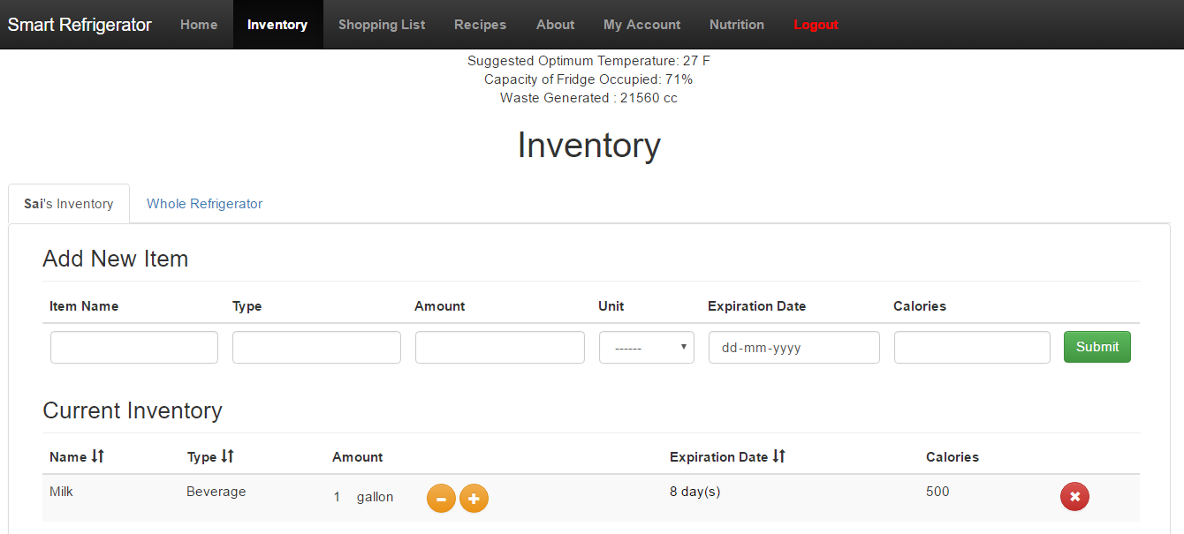
Scenario 5: I need to update my inventory from a receipt

Slide 31
Scenario 6: How much room is left in the fridge?

Slide 32
Scenario 0: I need to access the Kiosk

Slide 33
Scenario 1: I’m Hungry. What is there to eat?

Slide 34
Scenario 2: What Have I eaten today?

Slide 35
Scenario 3: What Should I eat?

Slide 36
Scenario 4: My weight has changed, I need to Update.

Slide 37
Scenario 5: I need to update my inventory from a receipt

Slide 38
Scenario 6: How much room is left in the fridge?

Slide 39


Future Improvements
d(WebPages)
Integrate both webpages
Sensors to go in “dumb” fridge
Improve GUI Design
Improve Meal Plan Design
Keep track OTC and Rx medicine
View eaten items

Slide 40

Special Thanks
ICEBOX Team
Ahmed Humayun
Sai Sivva
Li Zhen
Shu Yang

